Slide 1
EECS4484 malware CTF Presentation
Sean Malins-Umansky

Slide 2
Code Functionality

Slide 3
Functionality
Program does different things based on what flags are passed to it
(-r) Runtime Evasion: Process Hollowing
(-p) Persistence: Run on Startup
(-c) Network Connectivity: Connection to C2 Server
(-e) Encoding: XOR Encoding
(-d) Anti-Analysis
(-h) Anti-VM
Packed with UPX
2 Flags Hidden
Flag as String in Network Connectivity
Flag hidden from Strings in Encoding

Slide 4
Functionality
(-r) Runtime Evasion: Process Hollowing
Uses Windows API calls
Hollows out notepad.exe
Adds shellcode to display a MessageBox
Notepad.exe never shows text editor
(-p) Persistence: Run on Startup
Dynamically get the Path of the executable
Adds Entry to HK_CURRENT_USER\Software\Microsoft\Windows\CurrentVersion\Run
(-d) Anti-Analysis
Calls Windows API IsDebuggerPresent()
Displays MessageBox if Debugger is Present
Notes:
-r: Hollows Creates process for notepad.exe, hollows out the code, injects shellcode into notepad.exe, runs the process
-p: Adds the exe to the startup Registry
-d: Calls a Windows API. Displays MessageBox if true

Slide 5
Functionality
(-h) Anti-VM
Uses inline Assembly to execute cpuid and store registers ebx, ecx and edx in C variables.
eax is the input of cpuid and is 0x1
Then compares the 31st bit of ecx
(-c) Network Connectivity
Uses Windows Socket API (WSA) and Windows Sockets
Sends a Get request to a C2 server (C2.Sean.com)
Get Request contains first flag
Notes:
-h: Uses inline assembly to execute cupid. EAX is the input register, EBX, ECX, EDX are output
NOTE: According to documentation, when EAX = 1, ECX contains the environment information for the CPU
-c: Uses Windows Socket API (WSA) to open a socket and connect to an IP/C2 server

Slide 6
Functionality
(-e) Encoding: XOR Encoding
Decodes encoded char array using XOR and a char key
Creates a new Subkey under HK_CURRENT_USER\Software
Adds a new entry to the new Subkey
Flag 2
Notes:
Decodes a char array and creates a new Subkey and stores it as an entry

Slide 7
Malware Analysis Demo

Slide 8
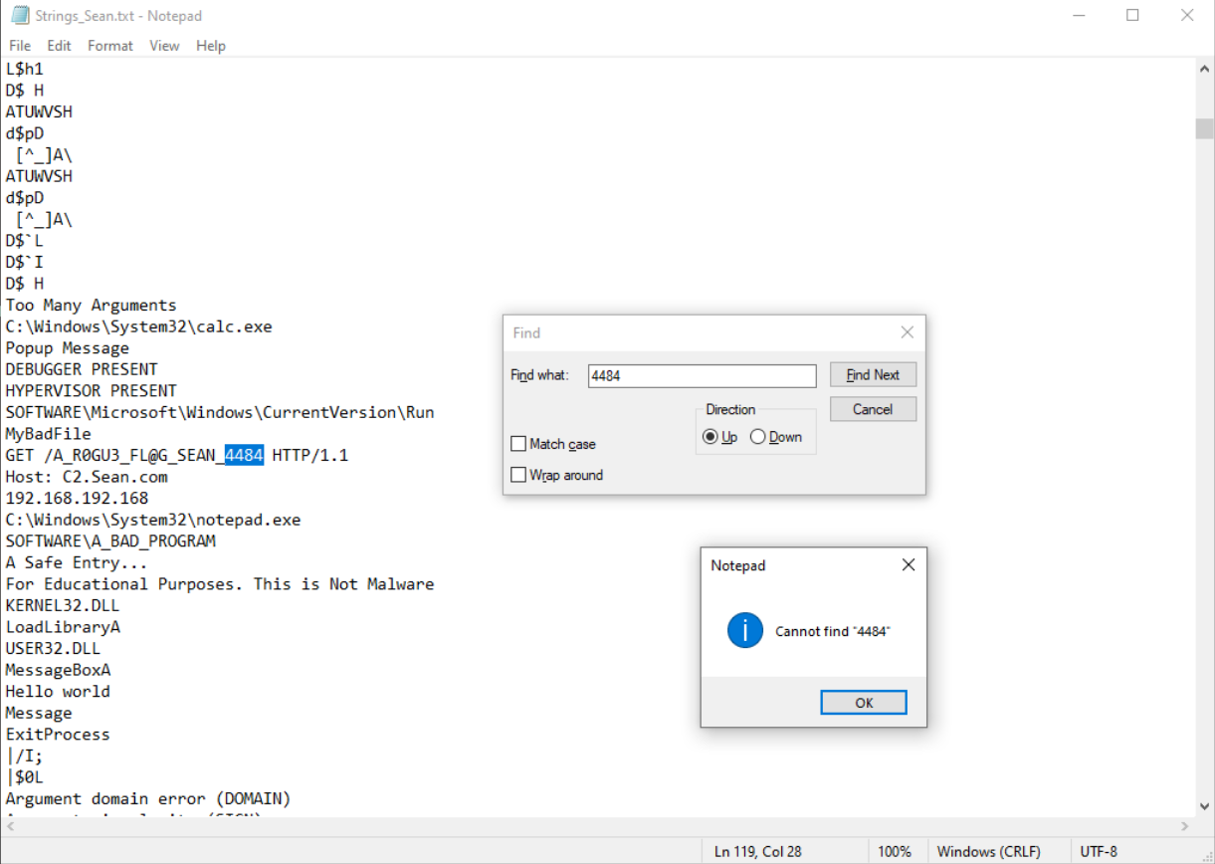
Strings
Notes:
Only see the first string Flag
Cannot see the second encoded flag
See C2 Server
Can See all API calls

Slide 9
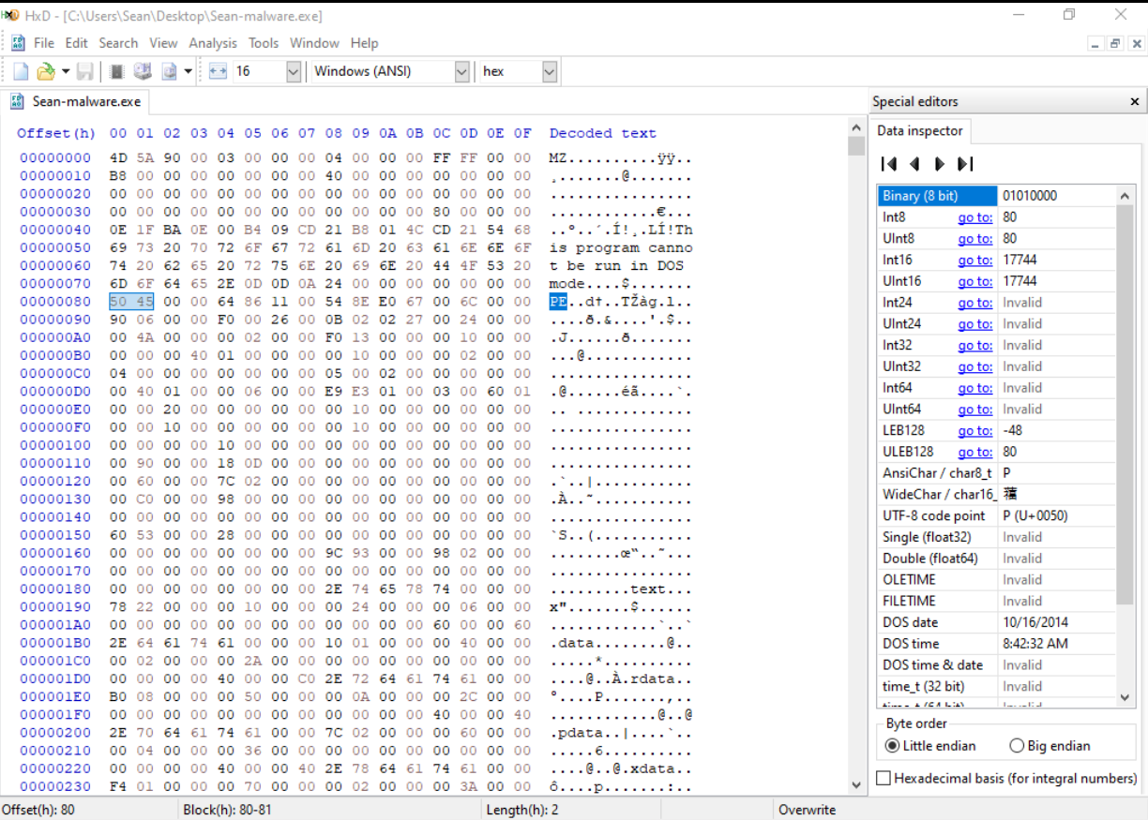
HxD
Notes:
4D 5A is present
0x00000030 points to 0x00000080
0x00000080 contains PE so it is a Portable Executable

Slide 10
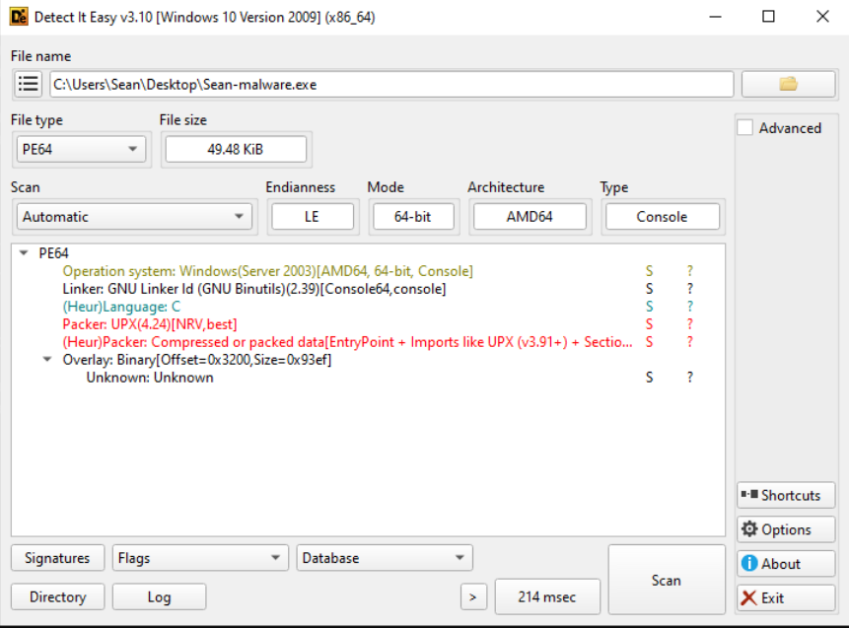
Detect-It Easy
Notes:
Shows UPX packing

Slide 11
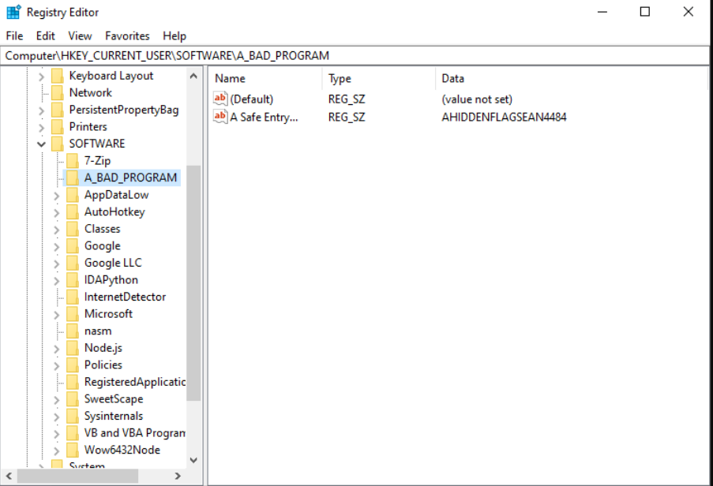
RegEdit
Notes:
Didn’t use Regshot but shows the same thing.
Just A lot of entries
Dynamic Flag exposed here

Slide 12
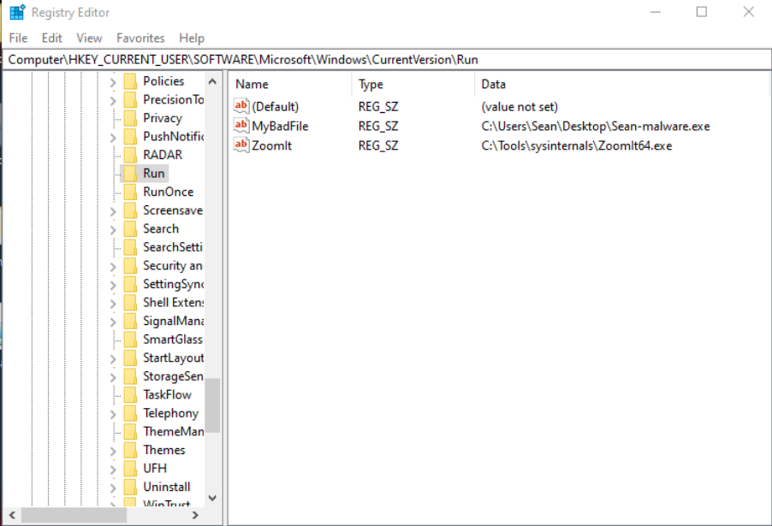
RegEdit
Notes:
Run folder added here

Slide 13
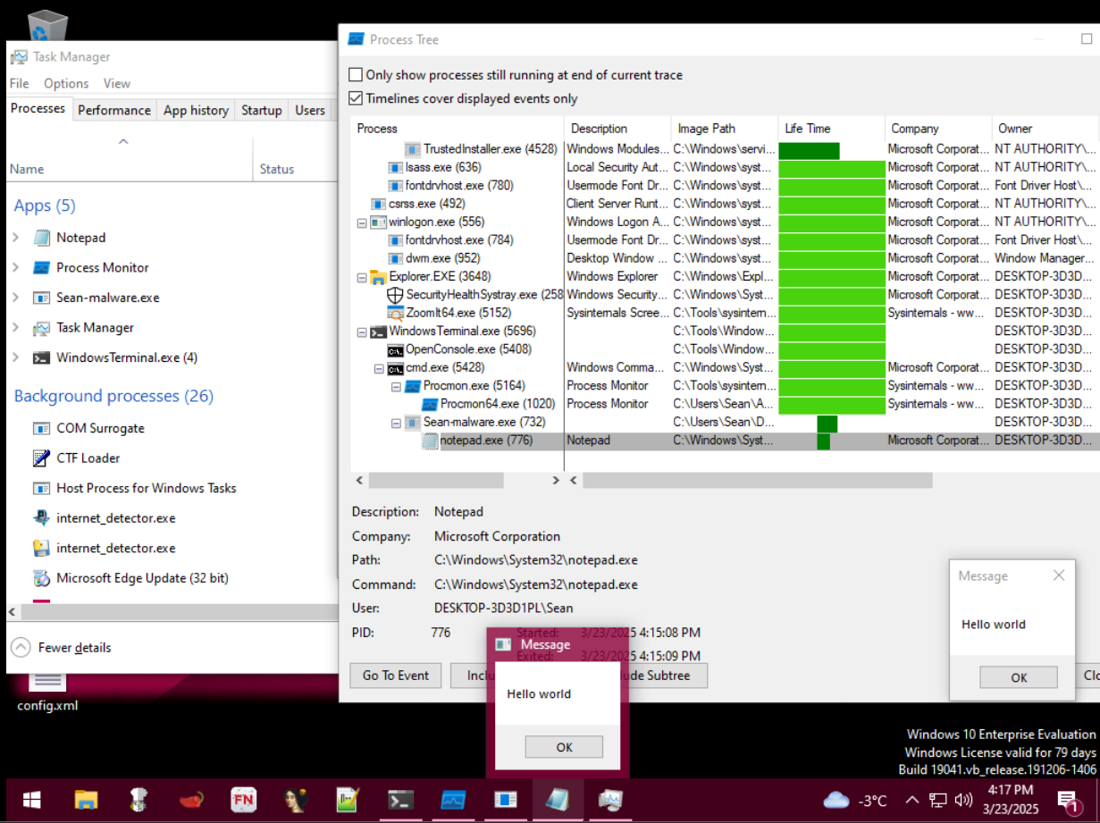
Procmon

Slide 14
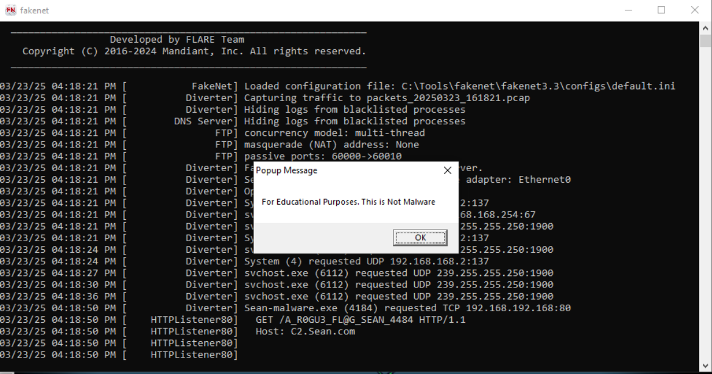
Fakenet

Slide 15
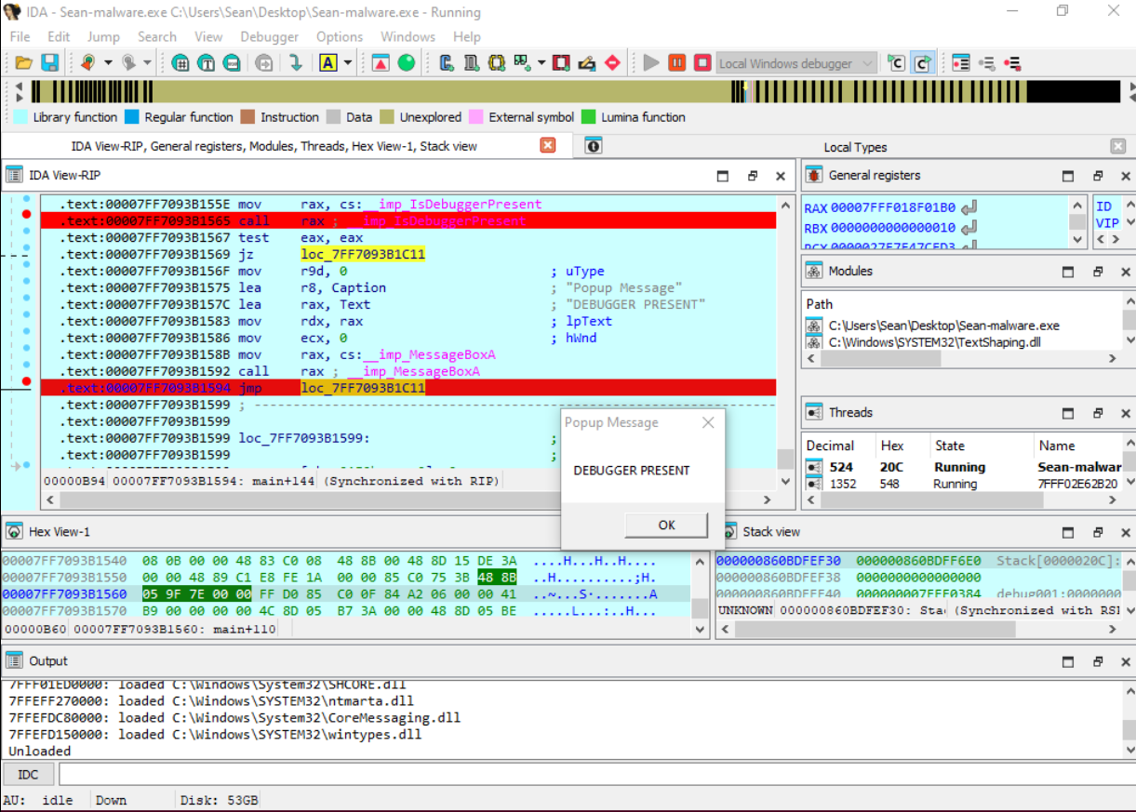
IDA

Slide 16
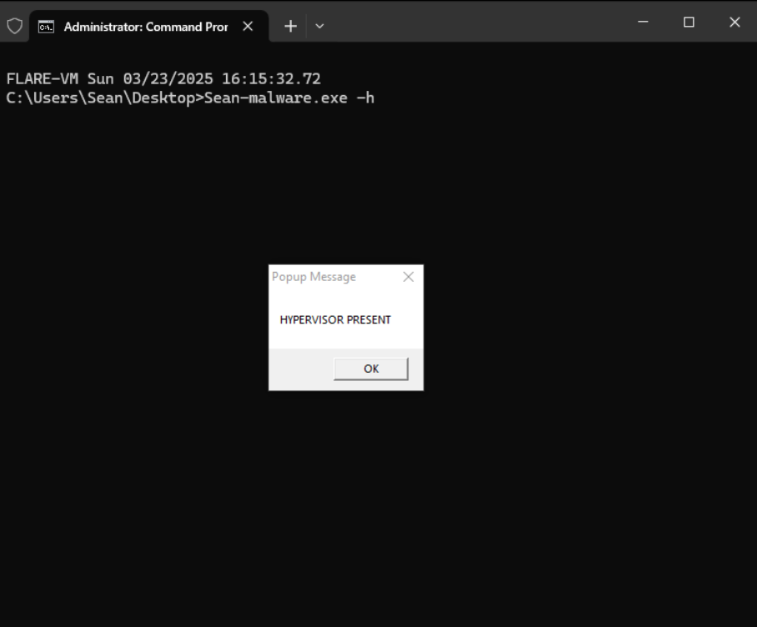
Terminal

Slide 17
Code Snippets

Slide 18
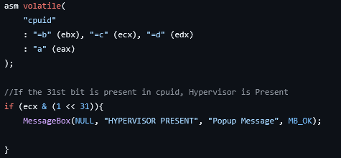
In-line Assembly
Notes:
cpuid is the assembly command we want to call
Eax is the input -> set that to 0x1
Ebx, Ecx, edx are output
Shift ecx 31 bits and compare

Slide 19
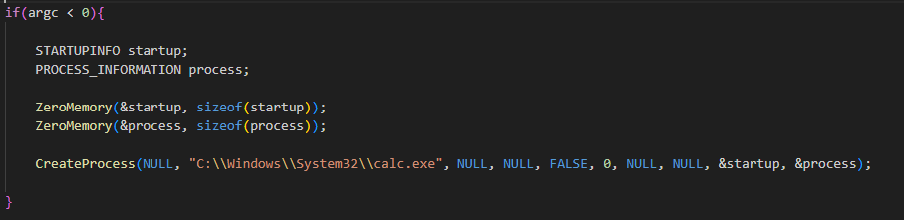
Obfuscated Code
Notes:
This will never run
Argc always has at least 1 because the file name is the first argument

Slide 20
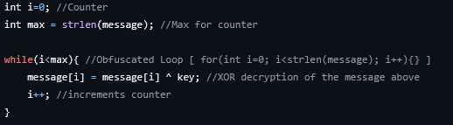
Obfuscated Code
Notes:
A for loop that is obfuscated into a while loop
Same functionality, Harder to analyze

Slide 21
EECS4484 malware CTF Presentation
Sean Malins-Umansky

